Slide 1

Digitization of legal deeds in the context of the modernization of public services
The notariat in the 21st century

Slide 2
General Principles of the Online Formation
1

Slide 3
Challenges
Challenge: Transfer of the functions of the involvement of the notary into the digital world
Aim: Easy and secure procedure
Goals:
ensure the reliable identification of the parties
check the legal capacity and free will of the parties
provide for comprehensive legal advice and high quality of the formation documents
create a digital authentic act (probative value, basis for registration)
Solution: Bundesnotarkammer creates an innovative and secure IT system for online procedures.

Slide 4

Solution 1: Videoconference
Best way to reproduce the authentication situation in the digital world
Notary can:
check the legal capacity and the free will of the parties
cancel the digital authentication in case of doubt
provide individual legal advice and develop tailor-made solutions
check the identity of parties via picture (see next slide)

Slide 5

Solution 2: Two-step identification
Weaknesses of other methods:
VideoIdent procedure: authenticity of the ID card held in the camera cannot be verified with certainty
Mere eID procedure: use of eIDs of other persons, psychological pressure and legal incapacity are not discernible
Therefore identification in two steps:
Identification on the basis of the eID data read out via smartphone
from documents with assurance level “high” under eIDAS Regulation
Identification on the basis of the photo read out via smartphone

Slide 6


Solution 3: Replacement of the parties‘ signatures
Problem: Signature of parties on paper no longer possible
Purpose of the parties’ signature:
Approval of parties
Attribute document to parties
Authenticity of notarised document
Solution: Signatures are replaced by qualified electronic signatures of the parties
  created by the certification body of Bundesnotarkammer (based on data in eID)
  attached to the electronic document via TAN on smartphone
  meets the assurance level “high” of eIDAS Regulation
  → Creation of an original electronic authentic instrument
omission of signature would significantly reduce value
of the authentic instrument

Slide 7






Solution 4: Standard hardware sufficient
Citizens only need…
1. standard laptop
2. standard smartphone
with
camera microphone internet
with
MRZ technology

Slide 8
Preparation of Remote Authentication
2

Slide 9
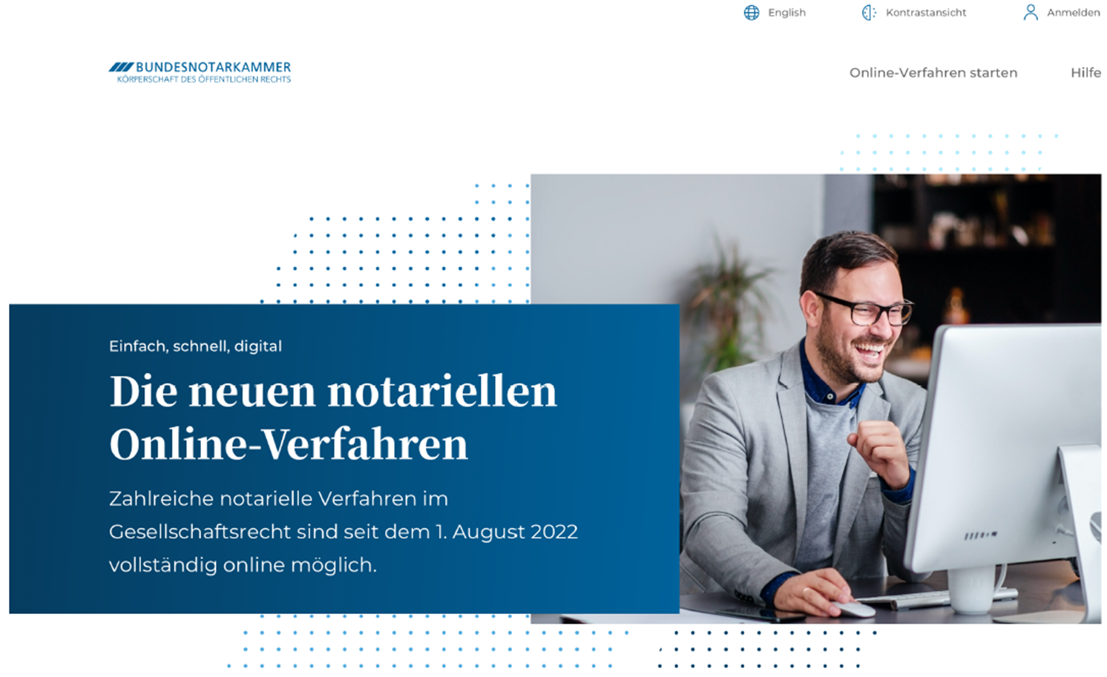
The online registration

Slide 10
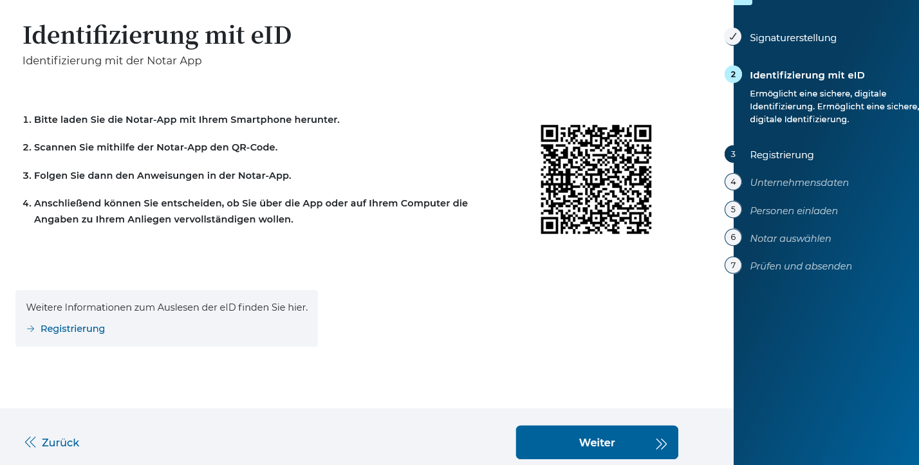
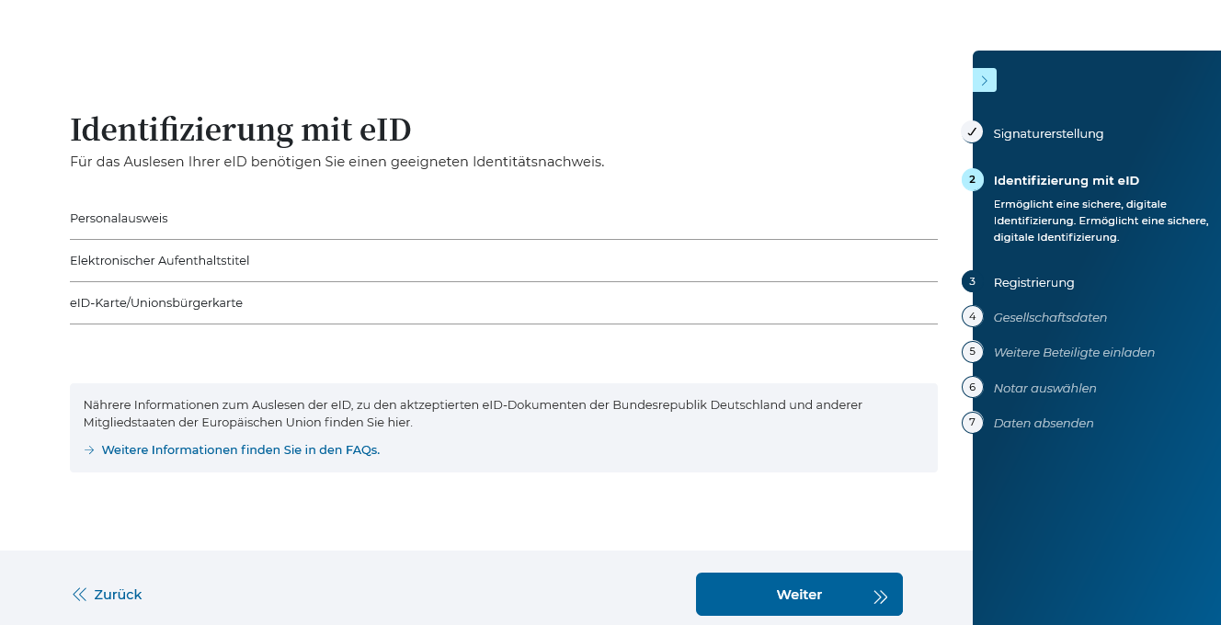
Registration via eID
Citizen scans QR code with smartphone
App opens
Citizen places ID card on smartphone
Citizen enters PIN
App on smartphone reads out eID (via NFC)
→ used for online-account
→ used to create qualified electronic signature
Notes:
pk

Slide 11
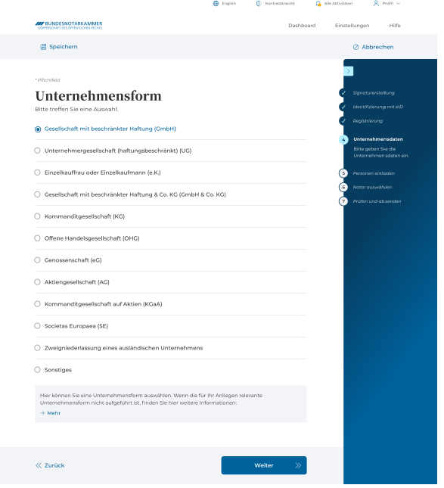
Entering data of the
Limited Liability Company
System can be used
to find a competent notary
to provide the notary with all necessary data for the formation of the company in structured form (optional) and
to send drafts
Notes:
ps

Slide 12
Remote Authentication
3

Slide 13
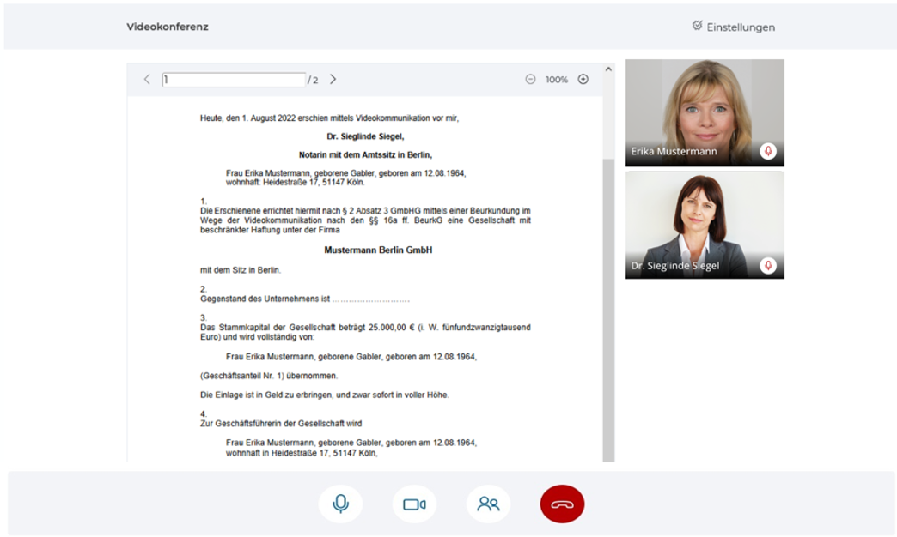
Videoconference – View of the citizen
13

Slide 14
Identification for the videoconference
Step 1 – eID
To fulfil highest security standards, the eID is read out again at the beginning of the videoconference
Notes:
pk

Slide 15
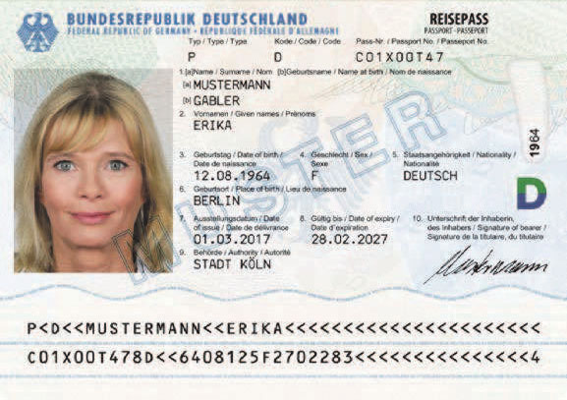
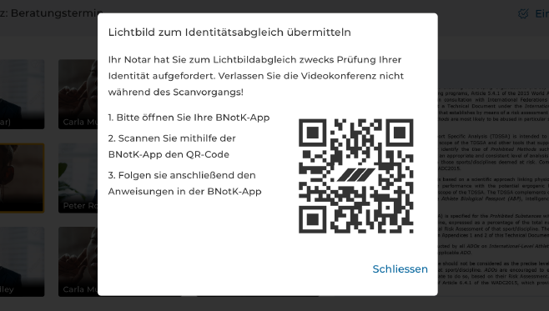
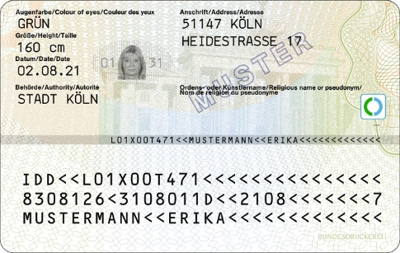
Identification for the videoconference
Step 2 – picture comparison
The picture from the ID card or passport is read out via the app
ODER
Notes:
pk

Slide 16
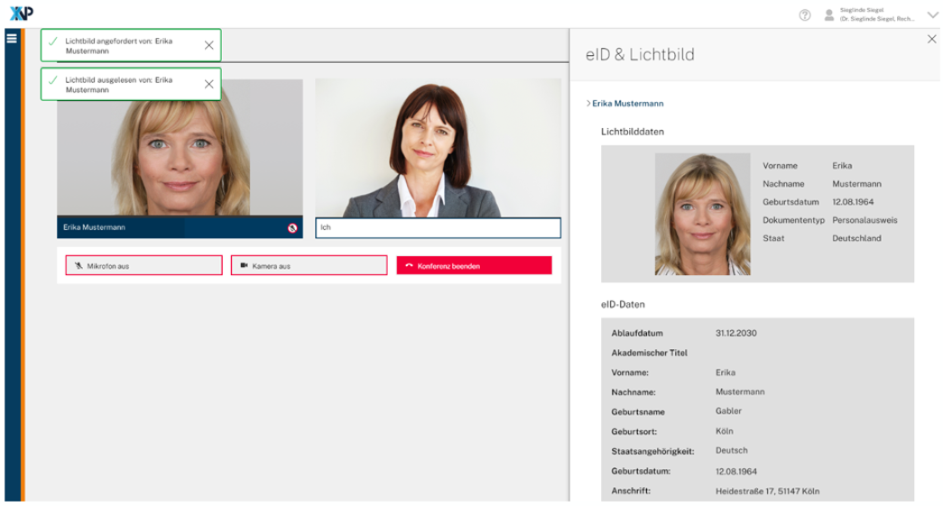
Identification for the videoconference
Step 2 – picture comparison
Notary can see picture read out from chip (right) and person appearing live in the videoconference (left)
person appearing in the videoconference
picture read out from chip
Notes:
pk

Slide 17
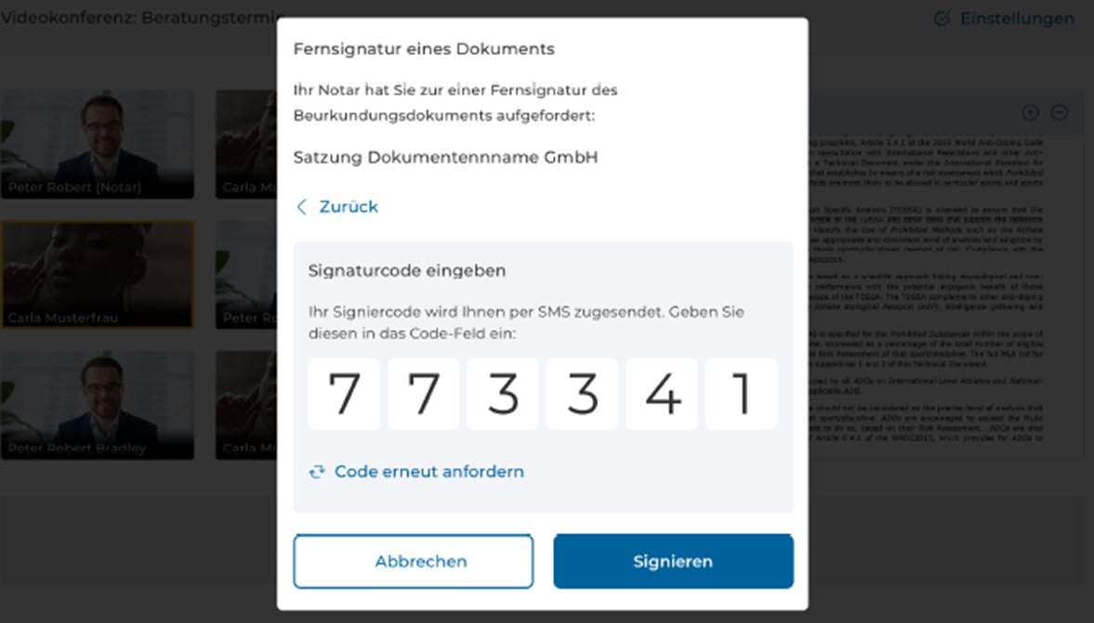
Qualified electronic signature on document
Notary asks parties to activate qualified electronic signature
TAN is automatically sent to smartphone
Citizen enters TAN on videoconference screen
Document signed digitally
Notary applies own qualified electronic signature
enter TAN sent to smartphone
Notes:
ps/pk

Slide 18
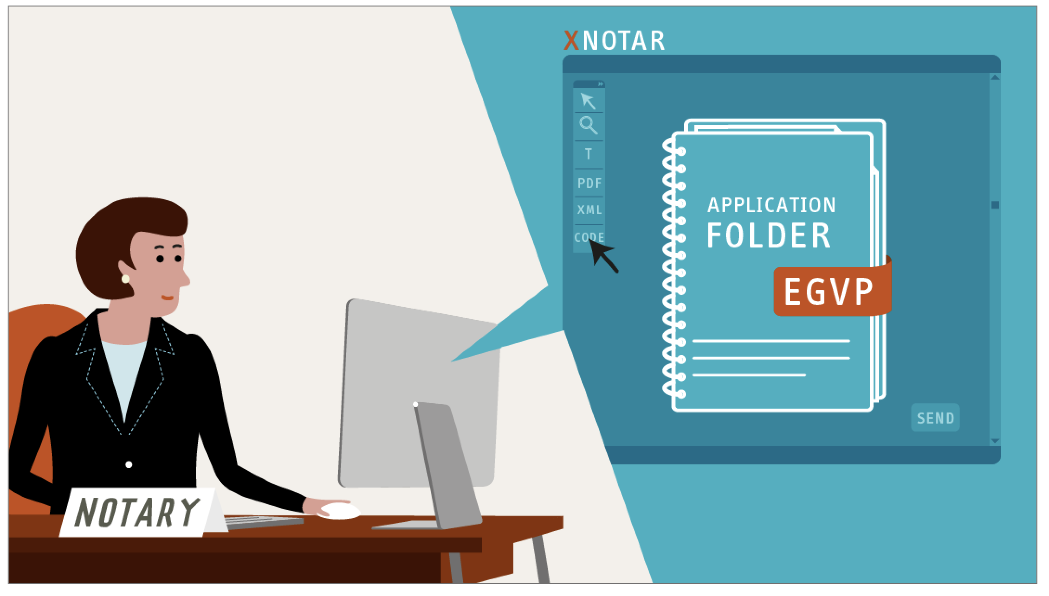
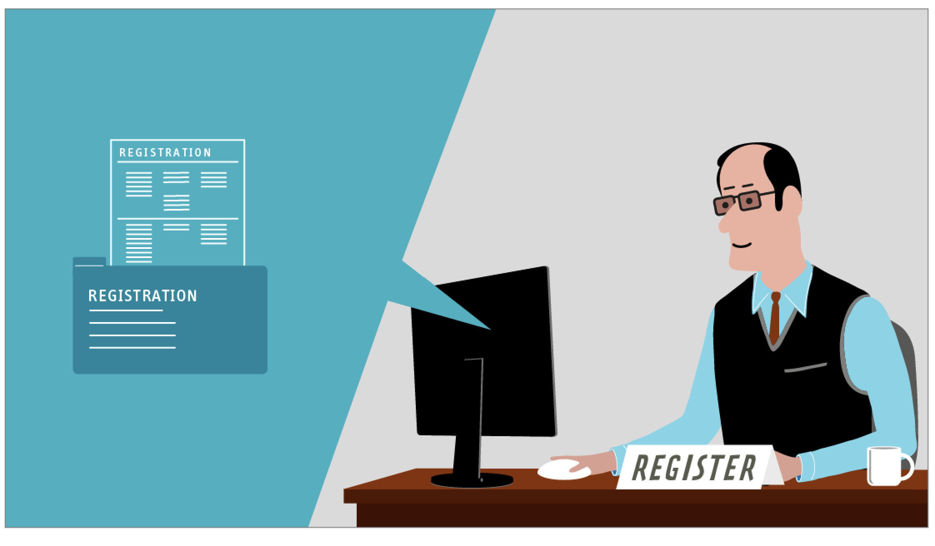
Integration into existing processes
Original electronic authentic act is automatically filed with the Electronic Archive of Authentic Acts
Electronically certified copy of the authentic act (instrument of incorporation) can be sent directly from the Electronic Archive of Authentic Acts to the business register

Slide 19
Electronic Archive of Authentic Acts
4

Slide 20

Electronic Archive of Authentic Acts
  Enables notaries to keep the Electronic Collection of Documents, the Directory of Documents and the Directory of Procedures
  Operated by Bundesnotarkammer as Archiving Authority for Authentic Acts: Bundesnotarkammer merely provides the infrastructure; notaries remain safeguarding bodies
  for paper documents and original electronic acts
  extremely high security standard
Notes:
Bitte Abfolge der Elemente nach Punkten

Slide 21
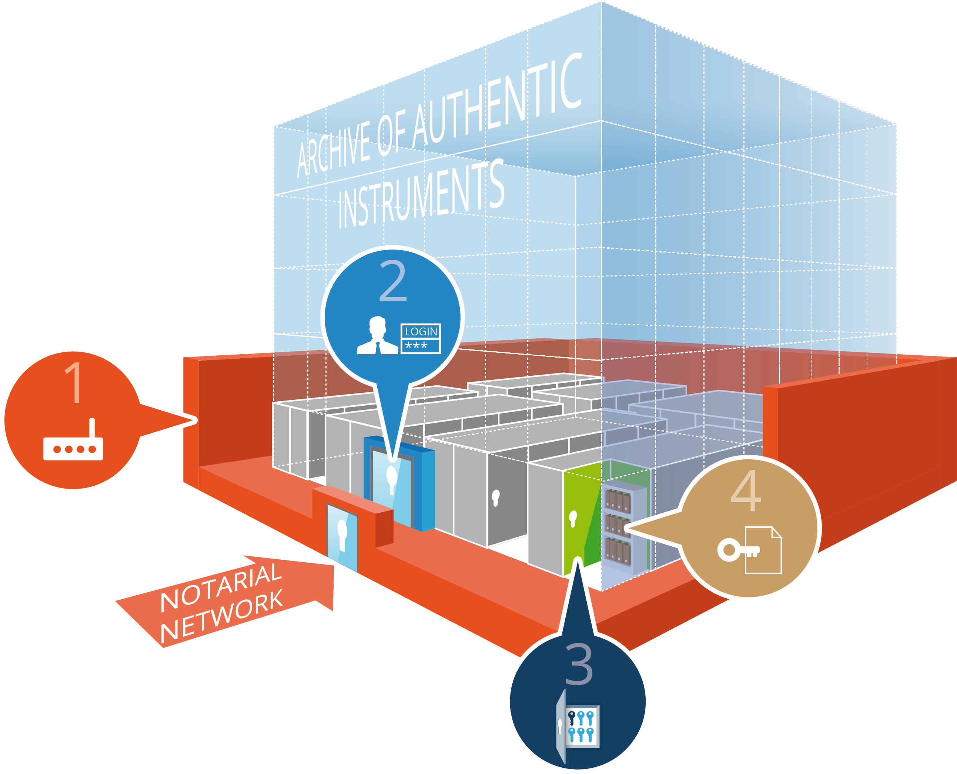
Security architecture
1. Notarial network as external protective barrier
2. Log on to the Electronic Archive of Authentic Acts with user name/password
3. Access to the notary‘s virtual archive room only granted to holders of the so-called “organisation key”
4. Each authentic act stored in the notary‘s archive room is individually protected by its own key
Notes:
Bitte erst Grafik, dann Textelemente chronologisch von 1 nach 4 erscheinen lassen

Slide 22
Outlook on the future impact of further IT developments
5

Slide 23

Templates – Smart contracts – Blockchain
Advantages
Disadvantages
Templates
  Can be created automatically
  Only cover certain standard situations
  Flexible situations require extra agreement
Smart Contracts
  Automatically executed
  Governed by fixed algorithms
do not allow for legal interpretation and
are not flexible for individual adjustments
Blockchain
  Secure storage space
  Does not guarantee that information entered is correct
Fast and (presumably) cheap
Lacking reliability and flexibility for individual solutions

Slide 24
Thank you for your attention!
Prof. Dr. Jens Bormann, LL.M. (Harvard)
President of the German Federal Chamber of Notaries

